Slide 1

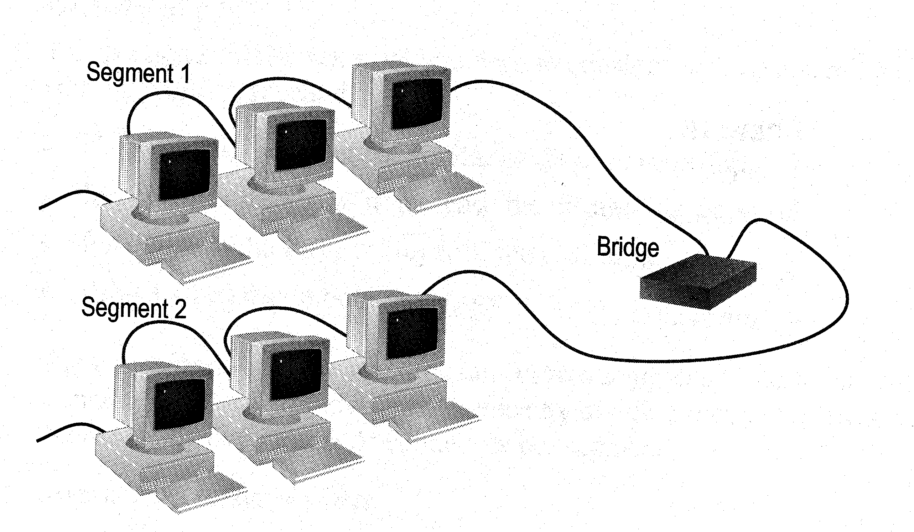
ENG224
INFORMATION TECHNOLOGY – Part I
8. Network Devices
8. Network Devices

Slide 2
ENG224
INFORMATION TECHNOLOGY – Part I
8. Network Devices
Functions of network devices
Separating (connecting) networks or expanding network
  e.g. repeaters, hubs, bridges, routers, brouters, switches, gateways
Remote access
  e.g. 56K Modems and ADSL modems

Slide 3
ENG224
INFORMATION TECHNOLOGY – Part I
8. Network Devices
A. Expanding Network
Networks cannot be made larger by simply adding new computers and more cables
  Less efficient !!
Can install components to
  segment (divide) large LAN to form smaller LANs
  connect LANs
Required components
  Repeaters, bridges, routers, brouters, switches or gateways

Slide 4
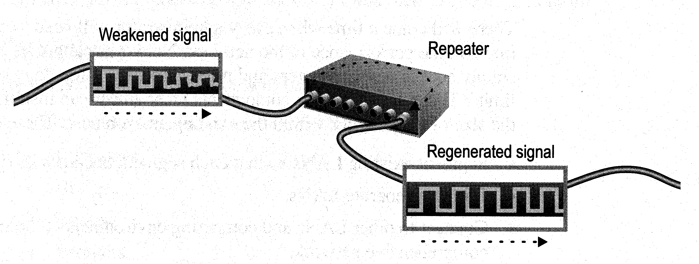
ENG224
INFORMATION TECHNOLOGY – Part I
8. Network Devices
a. Repeaters and Hubs
Repeaters or hubs work at the OSI physical layer to regenerate the network’s signal and resend them to other segments
Primitive hub can be viewed as a multiport repeater
  It regenerates data and broadcasts them to all ports
Hub

Slide 5
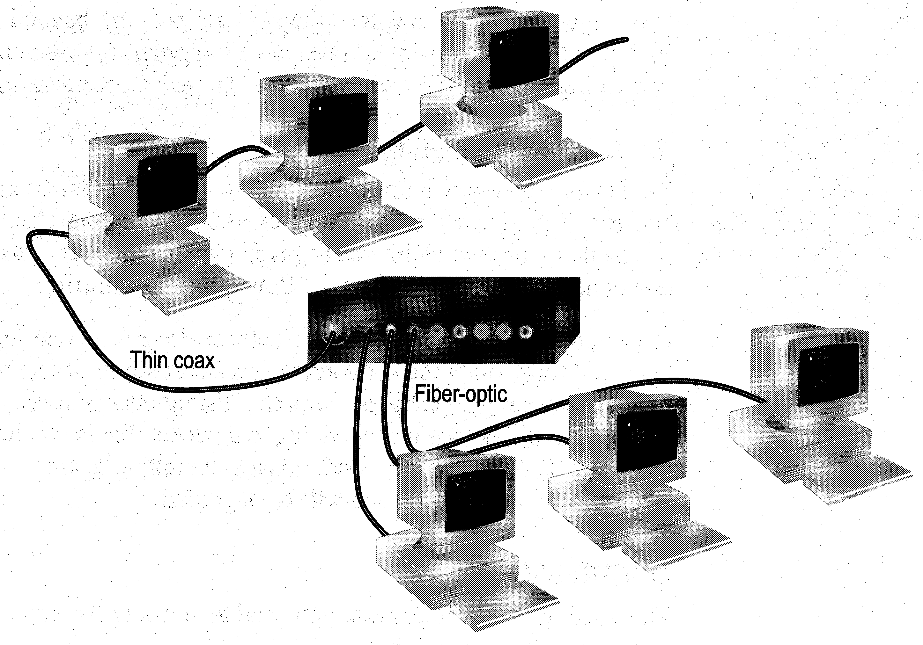
ENG224
INFORMATION TECHNOLOGY – Part I
8. Network Devices
Limitations and Features
Cannot link unlike segments
Cannot join segments with different access methods (e.g. CSMA/CD and token passing)
Do not isolate and filter packets
Can connect different types of media
The most economic way of expanding networks

Slide 6
ENG224
INFORMATION TECHNOLOGY – Part I
8. Network Devices
b. Bridges
Has one input and one output
Used to isolate network traffic and computers
Has the intelligent to examine incoming packet source and destination addresses
But cannot interpret higher-level information
Hence cannot filter packet according to its protocol

Slide 7
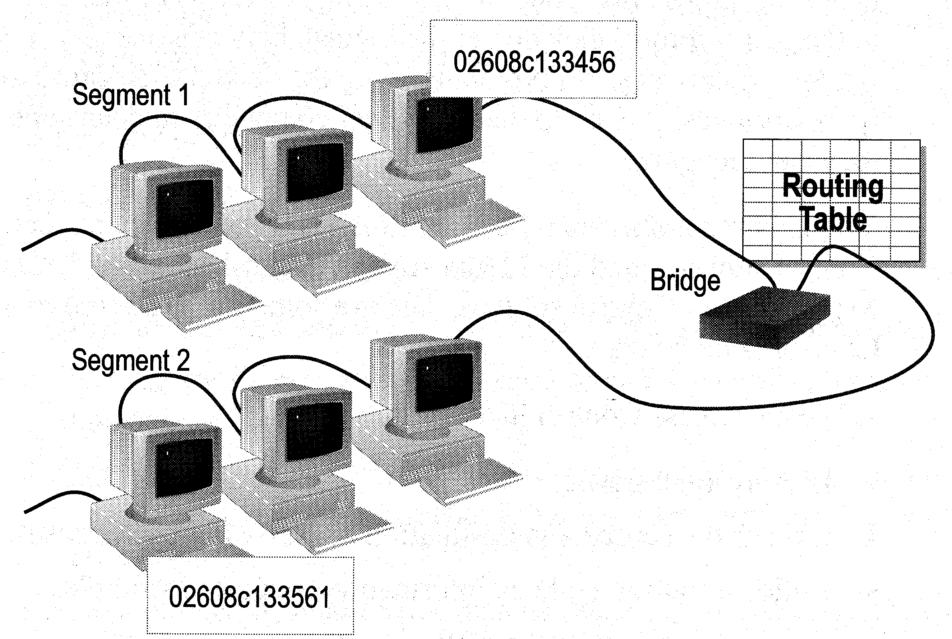
ENG224
INFORMATION TECHNOLOGY – Part I
8. Network Devices
How Bridges Work
Bridges work at the Media Access Control Sub-layer of the OSI model
  Routing table is built to record the segment no. of address
  If destination address is in the same segment as the source address, stop transmit
  Otherwise, forward to the other segment

Slide 8
ENG224
INFORMATION TECHNOLOGY – Part I
8. Network Devices
Creating a Switching Table
Based on the addresses of the sending computers
New addresses are added if they are not in the table
Add02
S 02 D 01
Switching Table
Seg 1 Seg 2
Add01
01
Stop
02
Add03
S 01 D 02

Slide 9
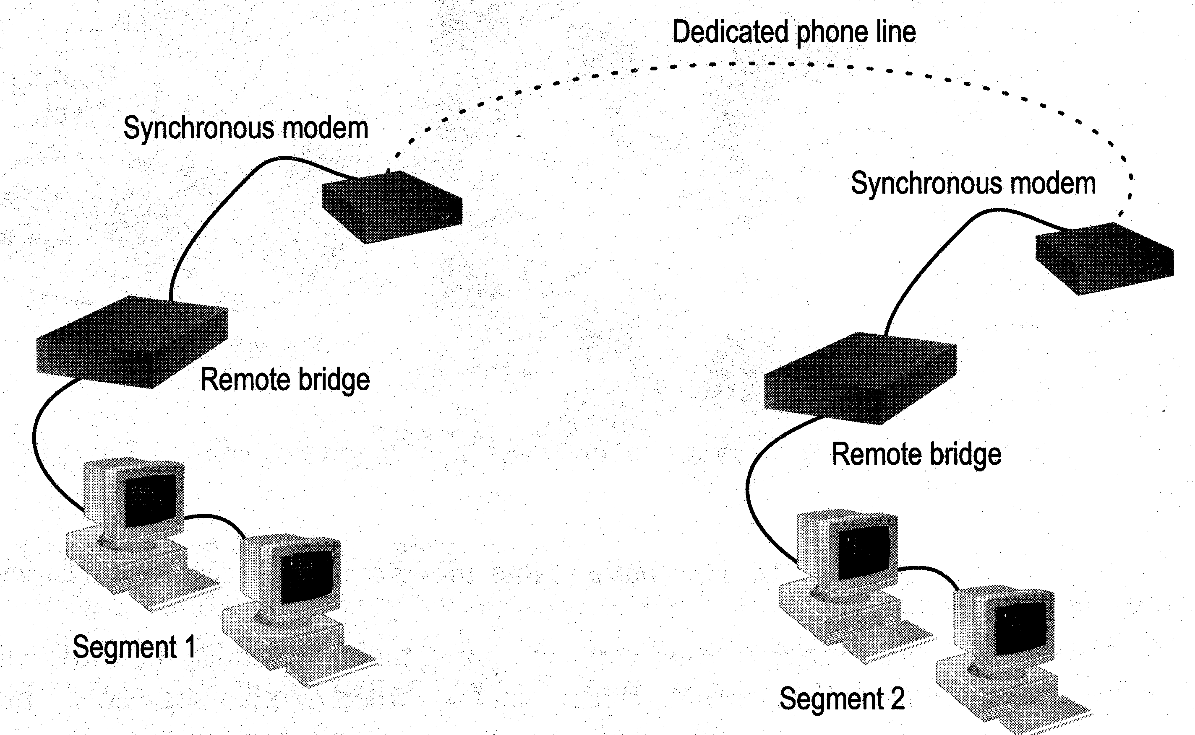
ENG224
INFORMATION TECHNOLOGY – Part I
8. Network Devices
Remote Bridges
Bridges are often used in large networks that have widely dispersed segments
Remote bridges can be used to connect remote segments via data-grade telephone line

Slide 10
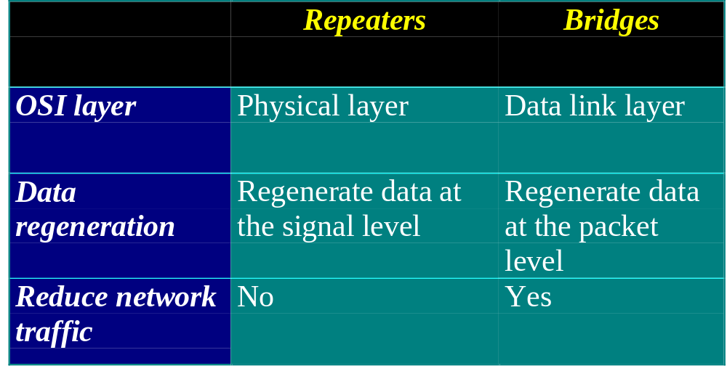
ENG224
INFORMATION TECHNOLOGY – Part I
8. Network Devices
Differences Between Bridges and Repeaters

Slide 11
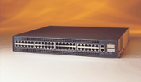
ENG224
INFORMATION TECHNOLOGY – Part I
8. Network Devices
c. Switches
Switches operate at the Data Link layer (layer 2) of the OSI model
Can interpret address information
Switches resemble bridges and can be considered as multiport bridges
By having multiports, can better use limited bandwidth and prove more cost-effective than bridge
Cisco Catalyst 2900 switch

Slide 12

ENG224
INFORMATION TECHNOLOGY – Part I
8. Network Devices
Switches divide a network into several isolated channels
Packets sending from 1 channel will not go to another if not specify
Each channel has its own capacity and need not be shared with other channels
Hub
3.3Mbps
10Mbps
Switch
3.3Mbps
3.3Mbps
10Mbps
10Mbps
10Mbps

Slide 13
ENG224
INFORMATION TECHNOLOGY – Part I
8. Network Devices
Advantages of Switches
Switches divide a network into several isolated channels (or collision domains)
  Reduce the possibility of collision
    Collision only occurs when two devices try to get access to one channel
    Can be solved by buffering one of them for later access
  Each channel has its own network capacity
    Suitable for real-time applications, e.g. video conferencing
  Since isolated, hence secure
    Data will only go to the destination, but not others

Slide 14
ENG224
INFORMATION TECHNOLOGY – Part I
8. Network Devices
Limitations of Switches
Although contains buffers to accommodate bursts of traffic, can become overwhelmed by heavy traffic
  Device cannot detect collision when buffer full
    CSMA/CD scheme will not work since the data channels are isolated, not the case as in Ethernet
  Some higher level protocols do not detect error
    E.g. UDP
  Those data packets are continuously pumped to the switch and introduce more problems

Slide 15
ENG224
INFORMATION TECHNOLOGY – Part I
8. Network Devices
Method of Switching - Cut Through Mode
Preamble
Des. Add
Sour. Add
Length
Data
FCS
7
Bytes
1
Byte
2/6
Bytes
2/6
Bytes
2
Bytes
46 - 1500 Bytes
4
Bytes
Read the first 14 bytes of each packet, then transmit
Much faster
Cannot detect corrupt packets
Can propagate the corrupt packets to the network
Best suited to small workgroups

Slide 16
ENG224
INFORMATION TECHNOLOGY – Part I
8. Network Devices
Method of Switching - Store and Forward Mode
Read the whole packet before transmit
Slower than the cut-through mode
More accurate since corrupt packets can be detected using the FCS
More suit to large LAN since they will not propagate error packets
Facilitate data transfer between segments of different speed
DB
100Mbps
10Mbps

Slide 17
ENG224
INFORMATION TECHNOLOGY – Part I
8. Network Devices
Using Switches to Create VLANs
Switches can logically group together some ports to form a virtual local area network (VLAN)
SW1
VLAN1
VLAN2
Hub
SW2
Hub
Switches can be configured to communicate only within the devices in the group
SW3
Hub

Slide 18
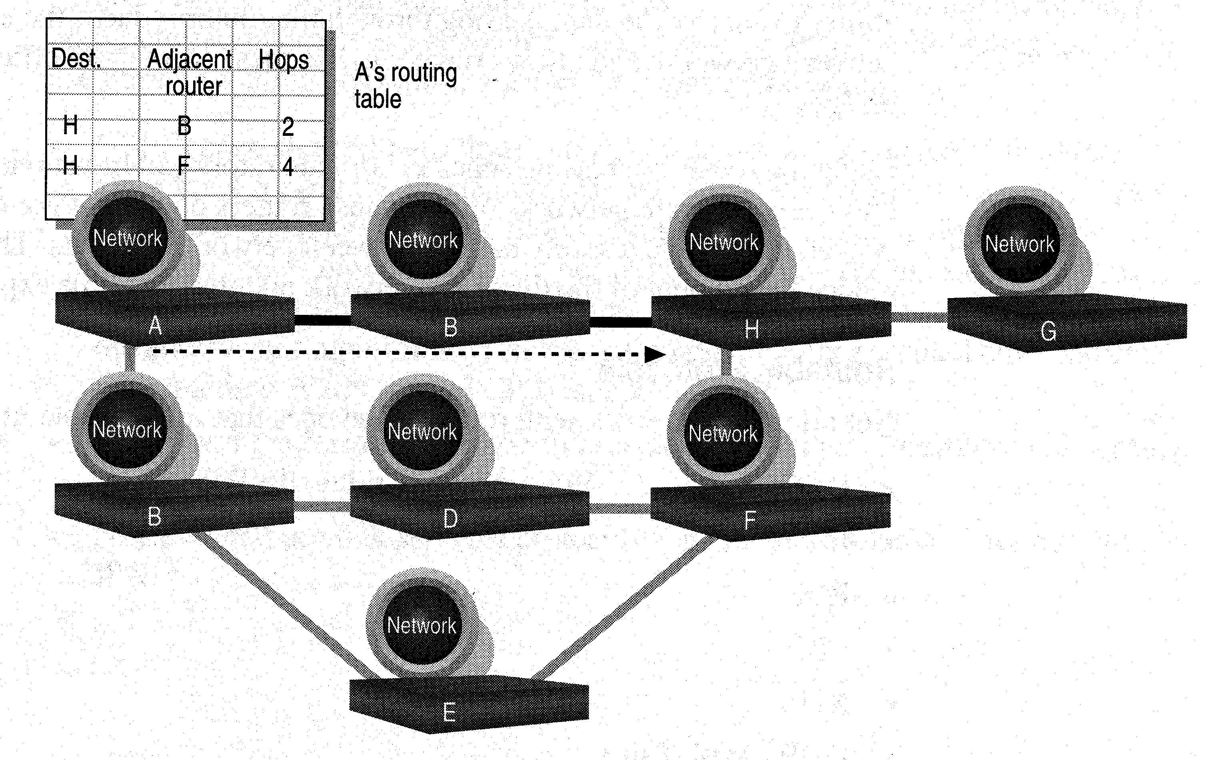
ENG224
INFORMATION TECHNOLOGY – Part I
8. Network Devices
d. Routers
Layer 2 Switches cannot take advantage of multiple paths
Routers work at the OSI layer 3 (network layer)
They use the “logical address” of packets and routing tables to determine the best path for data delivery

Slide 19
ENG224
INFORMATION TECHNOLOGY – Part I
8. Network Devices
How Routers Work
As packets are passed from routers to routers, Data Link layer source and destination addresses are stripped off and then recreated
Enables a router to route a packet from a TCP/IP Ethernet network to a TCP/IP token ring network
Only packets with known network addresses will be passed - hence reduce traffic
Routers can listen to a network and identify its busiest part
Will select the most cost effective path for transmitting packets

Slide 20
ENG224
INFORMATION TECHNOLOGY – Part I
8. Network Devices
How Routing Table is formed
Routing table is formed based on communications between routers using “Routing Protocols”
  Routing Protocols ≠ Routable Protocol
Routing Protocols collect data about current network status and contribute to selection of the best path
Routers communicate within themselves

Slide 21
ENG224
INFORMATION TECHNOLOGY – Part I
8. Network Devices
Routing Protocol Example - RIP for IP Routing
RIP (Routing Information Protocol) ― the oldest one
Use no. of hops between nodes to determine best path
Does not consider the network congestion condition
Broadcast every 30 sec the routing table to neighbouring routers to convey routing information
RIP is limited to interpreting a maximum of 16 hops
Not suitable for large network (e.g. Internet)
Can create excessive network traffic due to broadcasting
May take a long time to reach the far reaches

Slide 22
ENG224
INFORMATION TECHNOLOGY – Part I
8. Network Devices
Routing Protocol Example - OSPF for IP
OSPF - Open Shortest Path First
Make up the limitations of RIP - can coexist with RIP
In general case, best path refers to the shortest path
In case of traffic congestion, can go a longer path
Each router maintains a database of other router’s links
If link failure notice is received, router can rapidly compute an alternate path
Require more memory and CPU power

Slide 23
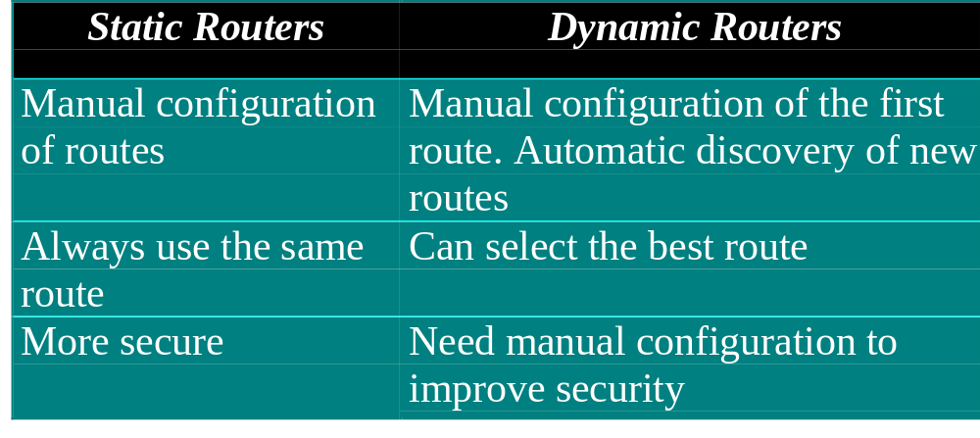
ENG224
INFORMATION TECHNOLOGY – Part I
8. Network Devices
Static and Dynamic Routers

Slide 24
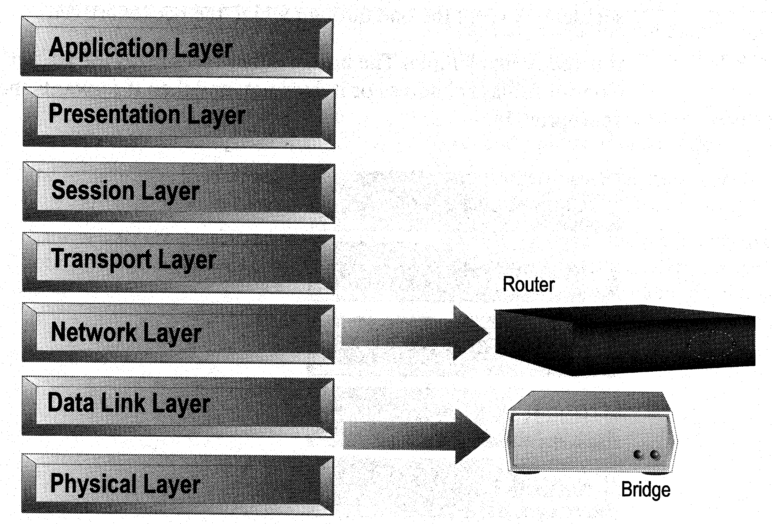
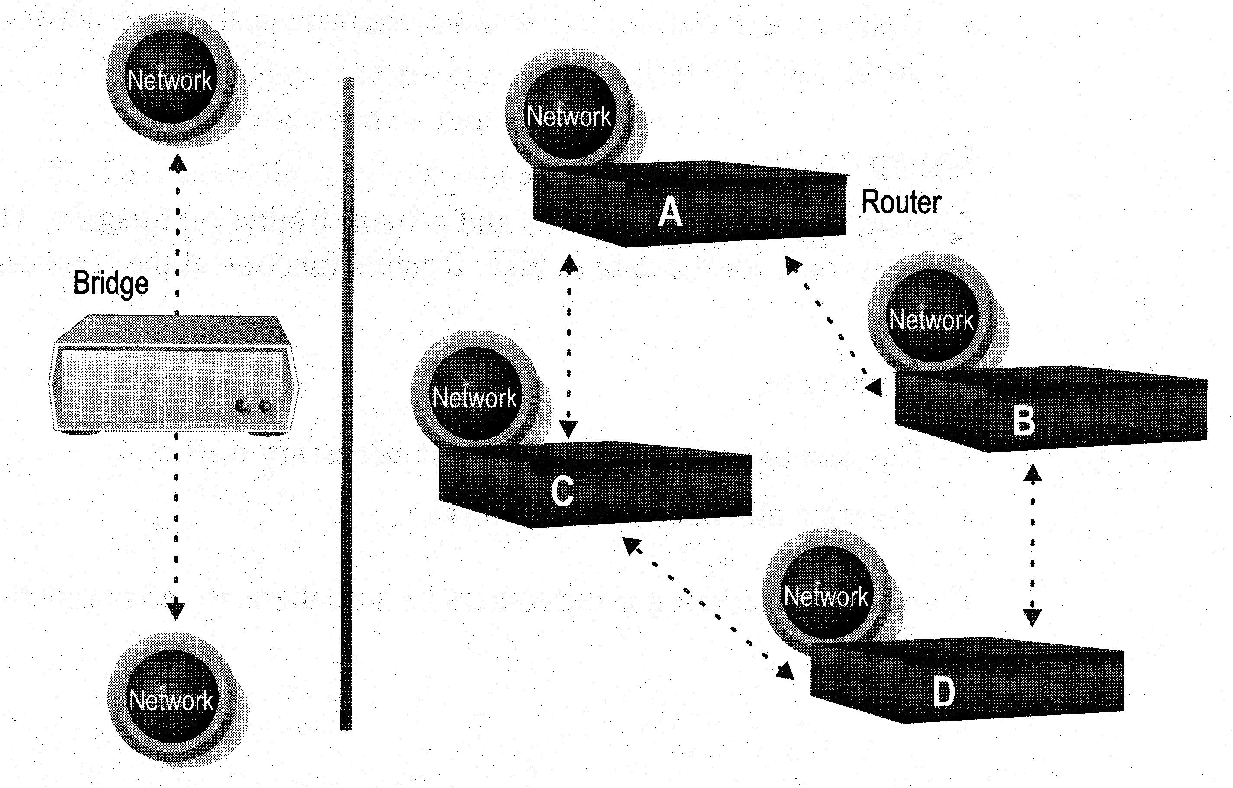
ENG224
INFORMATION TECHNOLOGY – Part I
8. Network Devices
Distinguishing Between Bridges and Routers
Bridges forward everything they don’t recognize
Routers select the best path
Routers are layer 3 devices which recognize network address
Bridges are layer 2 devices which look at the MAC sublayer node address

Slide 25
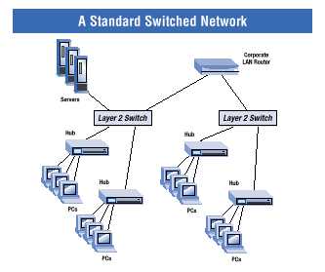
ENG224
INFORMATION TECHNOLOGY – Part I
8. Network Devices
Layer-3 Switches
Layer-3 switches operate in both layer 2 (data link layer) and 3 (network layer)
Can perform both MAC switching and IP routing
A combination of switch and router but much faster and easier to configure than router
Why Layer-3 switches?
Traffic of LAN is no longer local
Speed of LAN is much faster
Need a much faster router, however, very expensive
Excerpt from www.intel.com

Slide 26
ENG224
INFORMATION TECHNOLOGY – Part I
8. Network Devices
Summary
Repeaters are the least expensive way to expand a network, but they are limited to connecting two segments
Bridges function similar to repeaters, but can understand the node addresses
Switches can be considered as multiport bridges, can divide a network into some logical channels
Routers interconnect networks and provide filtering functions. They can determine the best route

Slide 27
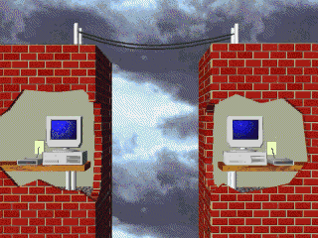
ENG224
INFORMATION TECHNOLOGY – Part I
8. Network Devices
B. Remote Access Devices
1. Modems
Allow computers to communicate over a telephone line
Enable communication between networks or connecting to the world beyond the LAN

Slide 28
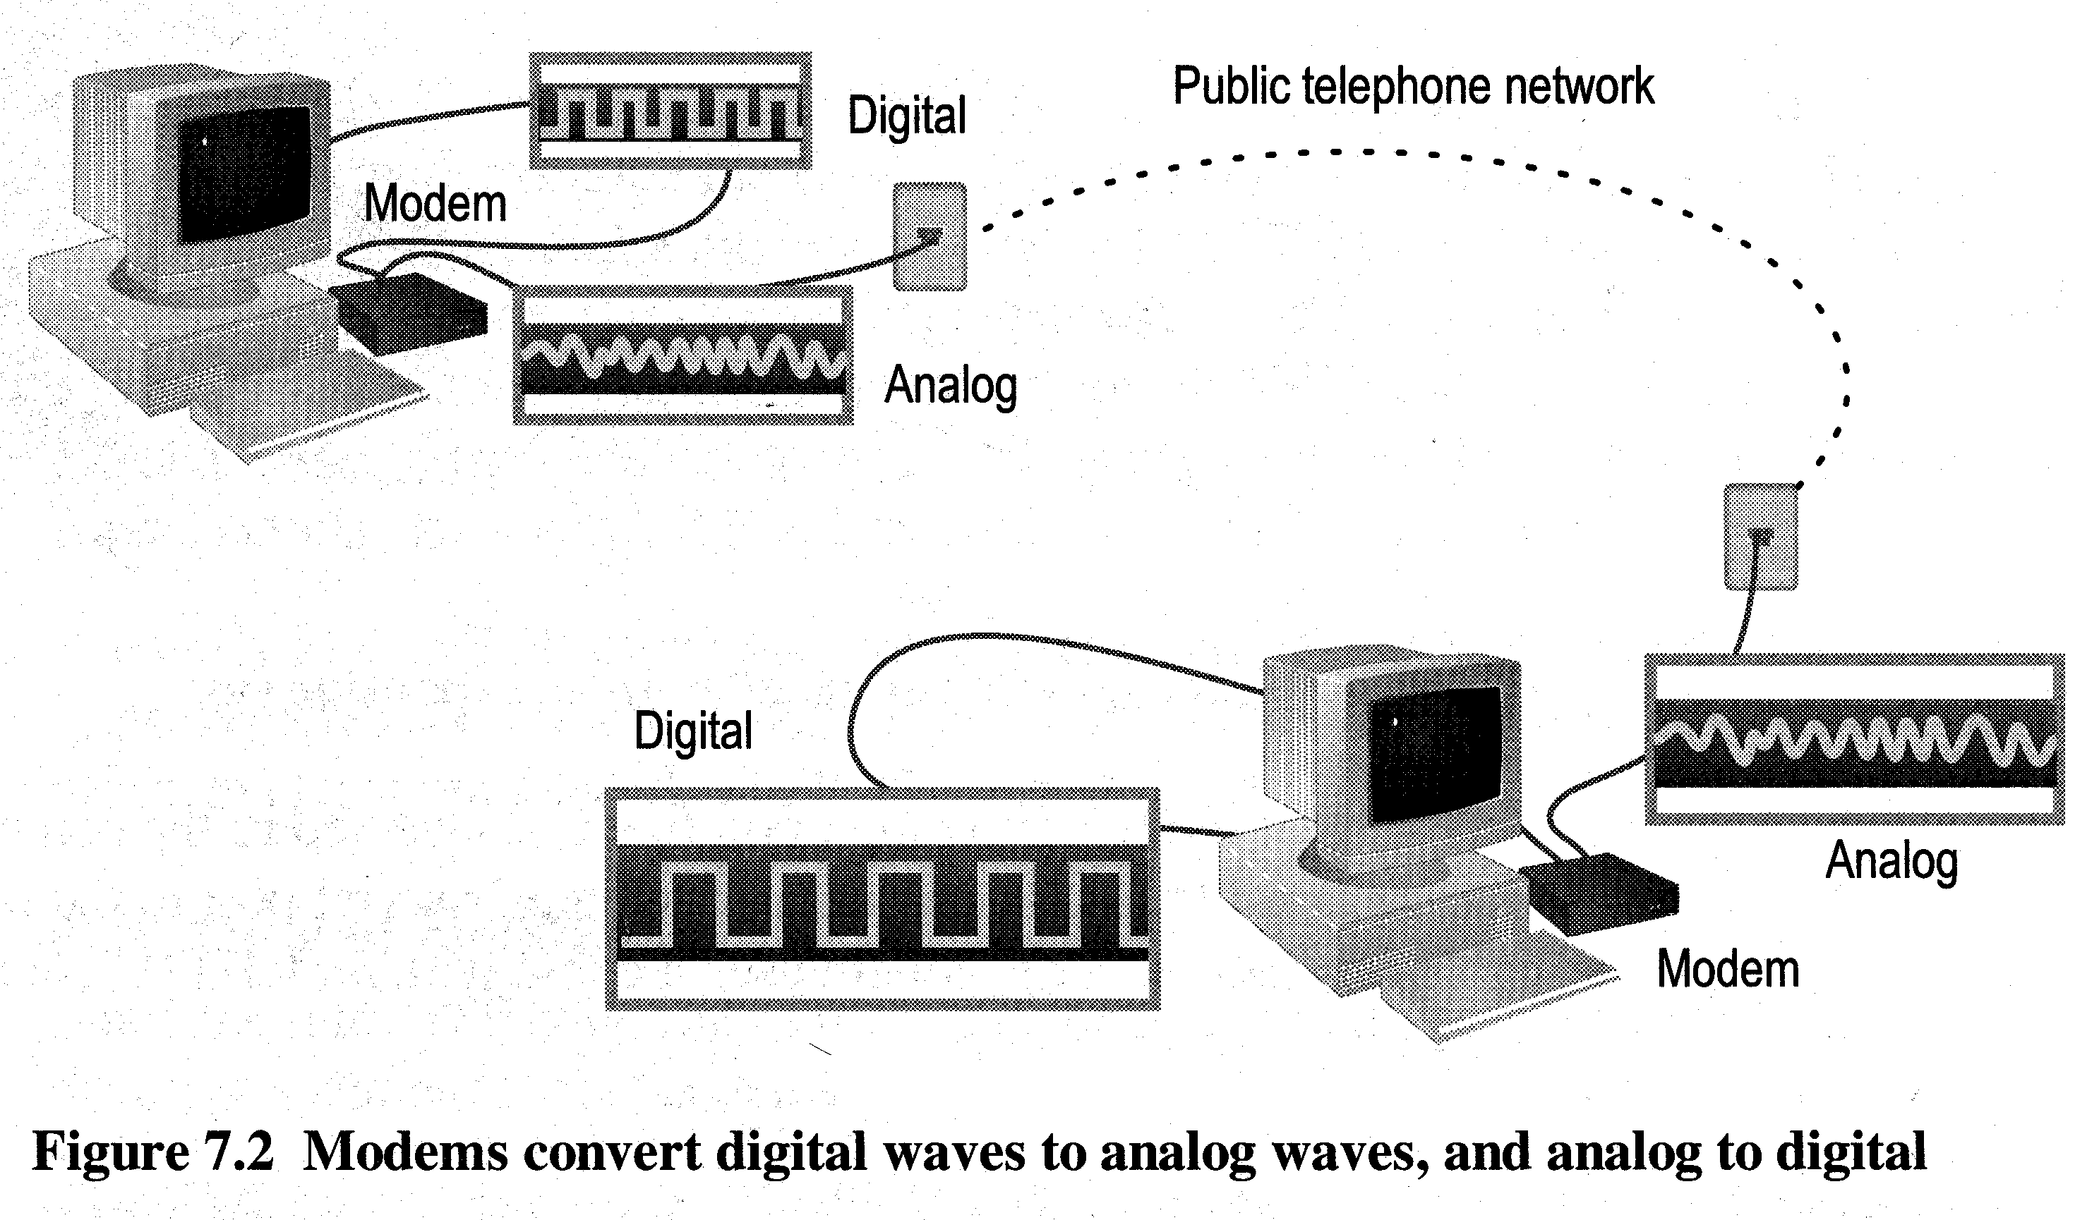
ENG224
INFORMATION TECHNOLOGY – Part I
8. Network Devices
Cannot send digital signal directly to telephone line
Sending end: MODulate the computer’s digital signal into analog signal and transmits
Receiving end: DEModulate the analog signal back into digital form

Slide 29
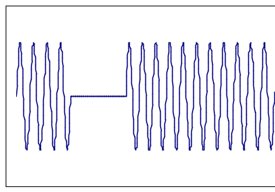
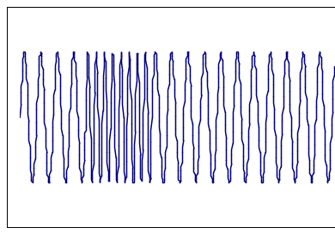
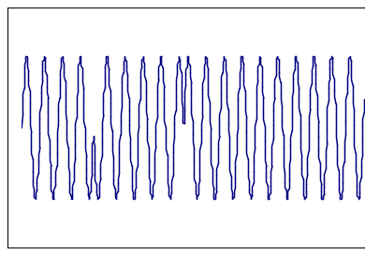
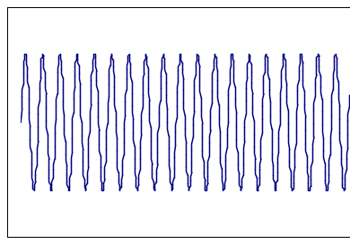
ENG224
INFORMATION TECHNOLOGY – Part I
8. Network Devices
1
0
1
1
1
Amplitude Modulation
Frequency Modulation
Phase Modulation
Normal sine wave

Slide 30

ENG224
INFORMATION TECHNOLOGY – Part I
8. Network Devices
Modems typically have the following I/O interface:
  A serial RS-232 communication interface
  An RJ-11 telephone-line interface (a telephone plug)
RS-232
RJ-11

Slide 31
ENG224
INFORMATION TECHNOLOGY – Part I
8. Network Devices
Modem Standards
Standard bps Introduced Remarks
V.22bis 2,400 1984
V.32 9,600 1984
V.32bis 14,400 1991
V.32terbo 19,200 1993 Communicate only with
another V.32terbo
V.FastClass 28,800 1993 (V.FC)
V.34 28,800 1994 Improved V.FC
V.42bis 115,200 1995 With compression
V.90 56,000 1998 Resolved competition
between X2 and Flex56k

Slide 32
ENG224
INFORMATION TECHNOLOGY – Part I
8. Network Devices
Modem Performance Measures
Baud rate - the number of symbol change per second on the transmission line
Bit per second (bps) - number of bits transmitted per second
In the past, they are identical
With compression technique, a change of signal can mean more than one bits
28.8kbaud can mean 115.2kbps when using V.42bis

Slide 33
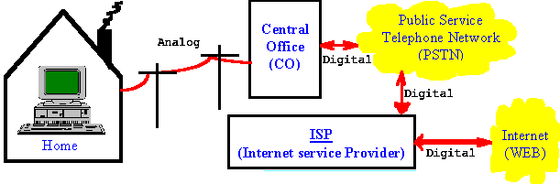
ENG224
INFORMATION TECHNOLOGY – Part I
8. Network Devices
How V.90 Works
Modem speed is determined by channel noise level
The noise level of traditional PSTN (public switch telephone network) limits data rate to ~35kbps
56K modem technology assumes only one analog link hence noise level is much lower

Slide 34
ENG224
INFORMATION TECHNOLOGY – Part I
8. Network Devices
Why V.90 cannot achieve 56kbps in practice?
The actual data link is 64kbps
To prevent interference and allow some overhead data in communication, ITU recommends a lower rate to 56 kbps
However, 56 kbps is a theoretical number
Depending on the quality and length of the analog link, the actual data rate can range from 30kbps to 53kbps

Slide 35
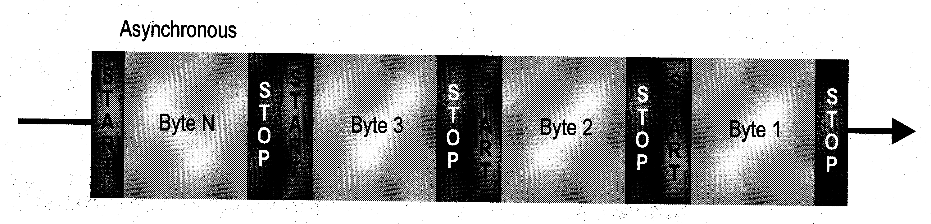
ENG224
INFORMATION TECHNOLOGY – Part I
8. Network Devices
Types of Modem - Asynchronous Modems
No clocking devices
Commonly used in telephone networks
Data is transmitted in a serial stream. Each character is turned into a string of 8 bits
Each of these characters is separated by one start bit and one or two stop bits

Slide 36
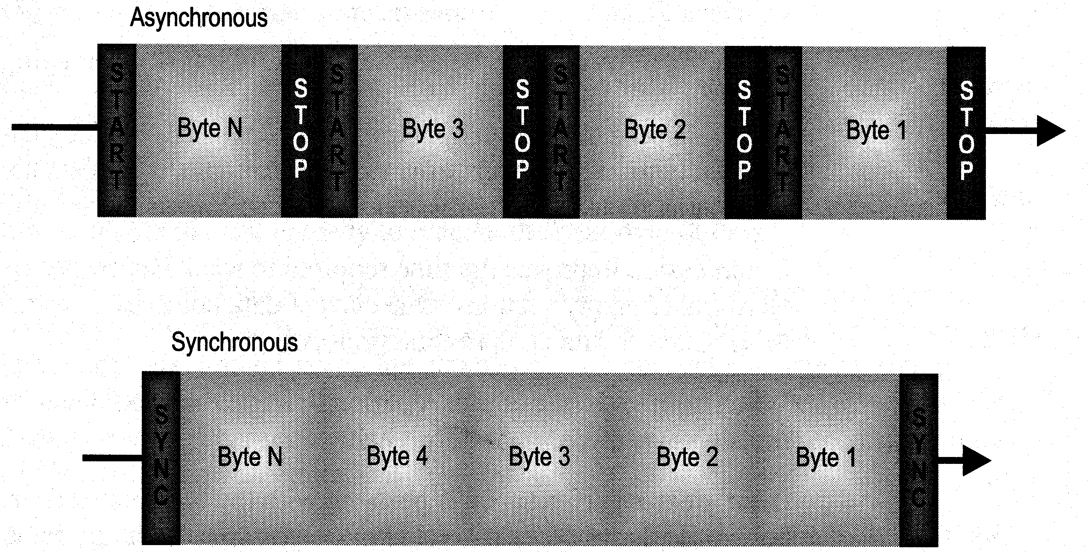
ENG224
INFORMATION TECHNOLOGY – Part I
8. Network Devices
Types of Modem - Synchronous Modems
Need clocking devices
Data are transmitted in blocks
Used in digital networks

Slide 37
ENG224
INFORMATION TECHNOLOGY – Part I
8. Network Devices
Comparison
Asynchronous modems are relatively simple and economic
  Large overhead - can be up to 20 to 27% of the data traffic
  Error control is done by using parity bit or higher layer protocols, e.g. MNP, V.42
Synchronous modems are relatively complicated and expensive
  Seldom use in home market
  Less overhead means higher efficiency
  More sophisticated error control protocol is required

Slide 38
ENG224
INFORMATION TECHNOLOGY – Part I
8. Network Devices
2. ADSL
ADSL stands for Asymmetric Digital Subscriber Line
Particularly suitable for high speed multimedia communications, general Internet applications
Asymmetric - downstream 1.5 to 6.1Mbps
upstream 16 to 640kbps
Digital - mainly for transmitting digital data
still require modulation and demodulation
Subscriber line - make use of the analog connection between household and CO

Slide 39


ENG224
INFORMATION TECHNOLOGY – Part I
8. Network Devices
ADSL Illustration
normal voice
2 to 3 miles
Telephone
Company
subscriber line
Splitter
local loop
low speed
data
high speed

Slide 40
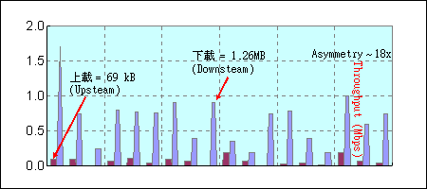
ENG224
INFORMATION TECHNOLOGY – Part I
8. Network Devices
Why Asymmetric?
In general Internet applications, downstream often requires a higher data rate than upstream
  Downstream - file download, video playback
  Upstream - click a link, send a form
Reducing the resource for upstream can provide more resource for downstream

Slide 41
ENG224
INFORMATION TECHNOLOGY – Part I
8. Network Devices
Why Subscriber Line?
By better controlling the length and quality of the analog connection between household and CO, a higher data rate can be achieved
Data Rate Wire Gauge Distance Wire Size Distance
1.5 or 2 Mbps 24 AWG 18,000 ft 0.5 mm 5.5 km
1.5 or 2 Mbps 26 AWG 15,000 ft 0.4 mm 4.6 km
6.1 Mbps 24 AWG 12,000 ft 0.5 mm 3.7 km
6.1 Mbps 26 AWG 9,000 ft 0.4 mm 2.7 km
More than 80% of the current installed subscriber lines can fulfill this requirement
Hence no extra cabling is required

Slide 42
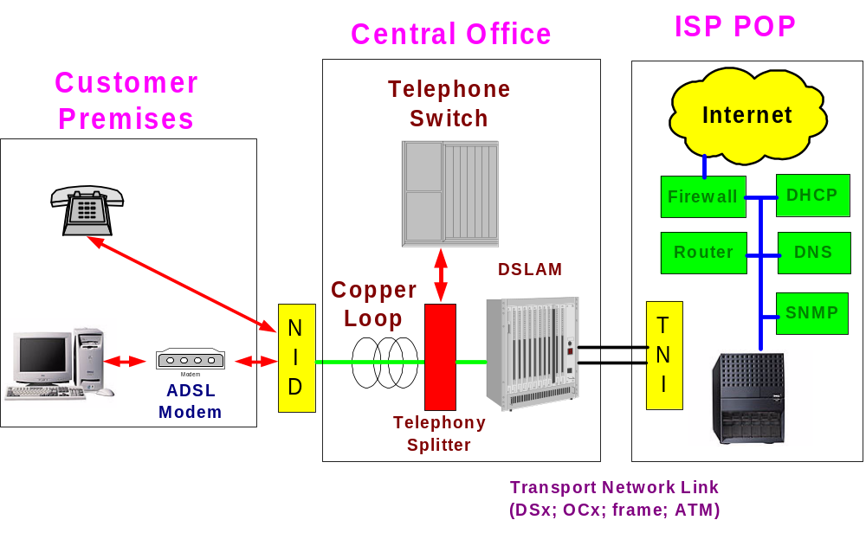
ENG224
INFORMATION TECHNOLOGY – Part I
8. Network Devices
Architecture of ADSL Services
DSLAM - Digital subscriber line access module (central office ADSL modem pool)

Slide 43
ENG224
INFORMATION TECHNOLOGY – Part I
8. Network Devices
Other DSL Technologies
HDSL – High speed DSL
  2 twisted pair, 12,000 feet
  1.5Mbps (DS1) full-duplex
  Symmetric
VDSL – Very high bit rate DSL
  Downstream: 52 Mbps (SONET STS-1) over 1000 feet; or 15 Mbps over 3000 feet
  Upstream: 1.5 to 2.3 Mbps
RDSL – Rate adaptive DSL
  Intelligent DSL to adjust data rate

